Slide 1





Slide 2

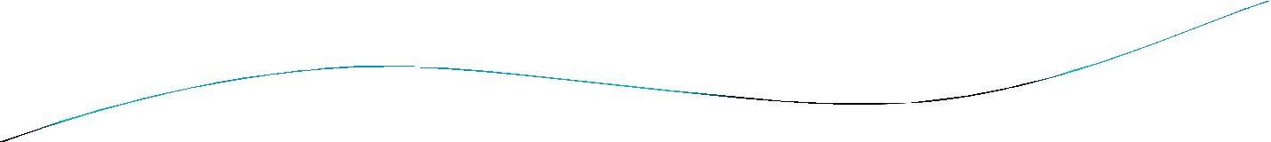





Presented BY
NAME CLASS COLLEGE
: ARUN KUMAR
: BSC IV SEM (C.S.)
: RAI SAHEB BHANWAR SINGH COLLEGE NASRULLAGANJ
SUBMITTED TO: GYAN RAO DHOTE
RAI SAHEB BHANWAR SINGH COLLEGE
NASRULLAGANJ
2

Slide 3


RAI SAHEB BHANWAR SINGH COLLEGE
NASRULLAGANJ
2

Slide 4
Gauss’s Law

Slide 5




Basic Concepts
Electric Flux Gauss’s Law
Applications of Gauss’s Law Conductors in Equilibrium

Slide 6

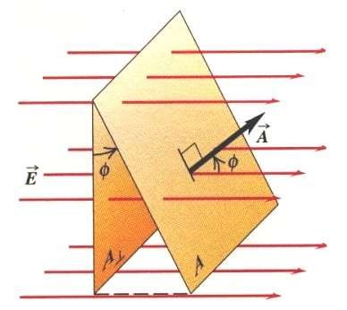
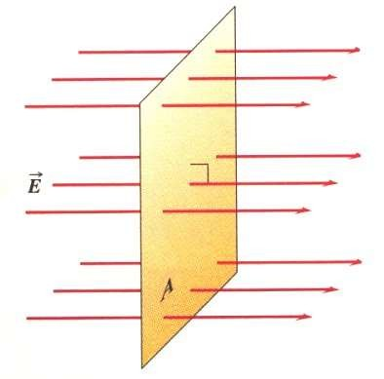
Electric Flux
The electric flux, Φ_{Ε}, through a surface is defined as the scalar product of E and A,
Φ_{Ε} = E⋅A. A is a vector perpendicular to the surface with a magnitude equal to the surface area. This is true for a uniform electric field.
A⊥ = A cosφ so Φ_{E} = EA⊥ = EA cosφ
Φ_{E} = EA

Slide 7

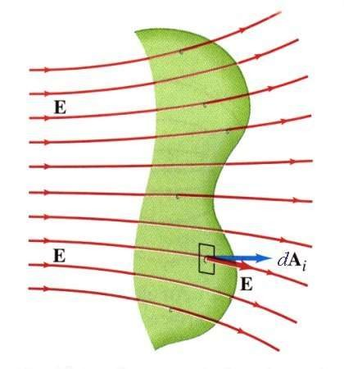
Electric Flux Continued
What about the case when the electric field is not uniform and the surface is not flat?
Then we divide the surface into small elements and add the flux through each.
Φ_{E} = ∑E_{i} ⋅d A_{i} → ∫ E ⋅d A
i

Slide 8


Worked Example 1
Compute the electric flux through a cylinder with an axis parallel to the electric field direction.
A
E
The flux through the curved surface is zero since E is perpendicular to dA there. For the ends, the surfaces are perpendicular to E, and E and A are parallel. Thus the flux through the left end (into the cylinder) is –EA, while the flux through right end (out of the cylinder) is +EA. Hence the net flux through the cylinder is zero.

Slide 9

Gauss’s Law
Gauss’s Law relates the electric flux through a closed surface with
the charge Q_{in} inside that surface.
r r
Φ = _{Ñ∫} E ⋅ dA = _{ε}
^{Q}in
E
0
This is a useful tool for simply determining the electric field, but only for certain situations where the charge distribution is either rather simple or possesses a high degree of symmetry.

Slide 10

Problem Solving Strategies for Gauss’s Law
Select a Gaussian surface with symmetry that matches the charge distribution
Draw the Gaussian surface so that the electric field is either constant or zero at all points on the Gaussian surface
Use symmetry to determine the direction of E on the Gaussian surface
Evaluate the surface integral (electric flux) Determine the charge inside the Gaussian surface
Solve for E

Slide 11

Conductors in Electrostatic Equilibrium
By electrostatic equilibrium we mean a situation where there is no net motion of charge within the conductor
The electric field is zero everywhere inside the conductor
Any net charge resides on the conductor’s surface The electric field just outside a charged conductor is perpendicular to the conductor’s surface

Slide 12

Conductors in Electrostatic Equilibrium
The electric field is zero everywhere inside the conductor Why is this so?
If there was a field in the conductor the charges would accelerate under the action of the field.
^{E}in
++++++++++++
The charges in the conductor
move creating an internal electric field that cancels the applied field on the inside of the conductor
E
E

Slide 13

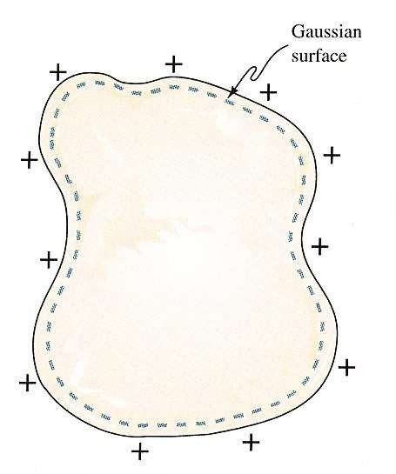
Worked Example 4
Any net charge on an isolated conductor must reside on its surface and the electric field just outside a charged conductor is perpendicular to its surface (and has magnitude σ/ε₀). Use Gauss’s law to show this.
For an arbitrarily shaped conductor we can draw a Gaussian surface inside the conductor. Since we have shown that the electric field inside an isolated conductor is zero, the field at every point on the Gaussian surface must be zero.
r r
_{Ñ∫} E ⋅ dA = _{ε}
^{Q}in
0
From Gauss’s law we then conclude that the net charge inside the Gaussian surface is zero. Since the surface can be made arbitrarily close to the surface of the conductor, any net charge must reside on the conductor’s surface.

Slide 14

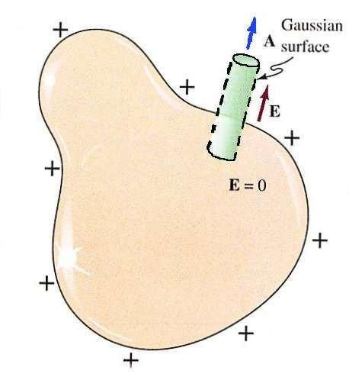
Worked Example 4 cont’d
We can also use Gauss’s law to determine the electric field just outside the surface of a charged conductor. Assume the surface charge density is σ.
Since the field inside the conductor is zero there is no flux through the face of the cylinder inside the conductor. If E had a component along the surface of the conductor then the free charges would move under the action of the field creating surface currents. Thus E is perpendicular to the conductor’s surface, and the flux through
the cylindrical surface must be Consequently the net flux through cylinder is EA and Gauss’s law gives:
zero.
the
Φ = EA = ^{Qin} = ^{σ A} or E = ^{σ}
E
ε ε ε
0
0 0

Slide 15

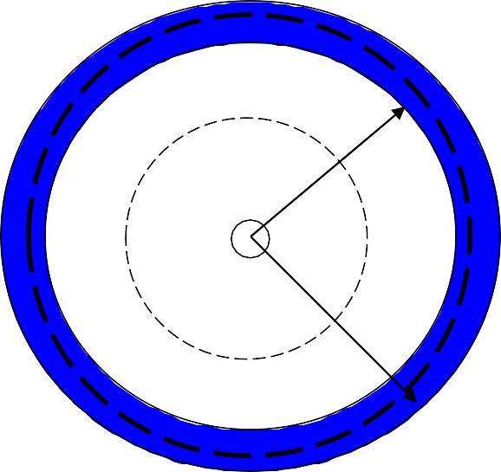

Worked Example 5
A conducting spherical shell of inner radius a and outer radius b with a net charge
-Q is centered on point charge +2Q. Use Gauss’s law to find the electric field everywhere, and to determine the charge distribution on the spherical shell.
First find the field for 0 < r < a
This is the same as Ex. 2 and is the field due to a point charge with charge +2Q.
-Q
a
+2Q
E = k ^{2Q}
e
_{r} 2
b
Now find the field for a < r < b
The field must be zero inside a conductor in equilibrium. Thus from Gauss’s law Q_{in} is zero. There is a + 2Q from the point charge so we must have Q_{a =} -2Q on the inner surface of the spherical shell. Since the net charge on the shell is -Q we can get the charge on the outer surface from Q_{net} = Q_{a} + Q_{b}.
Q_{b}= Q_{net} - Q_{a} = -Q - (-2Q) = + Q.

Slide 16

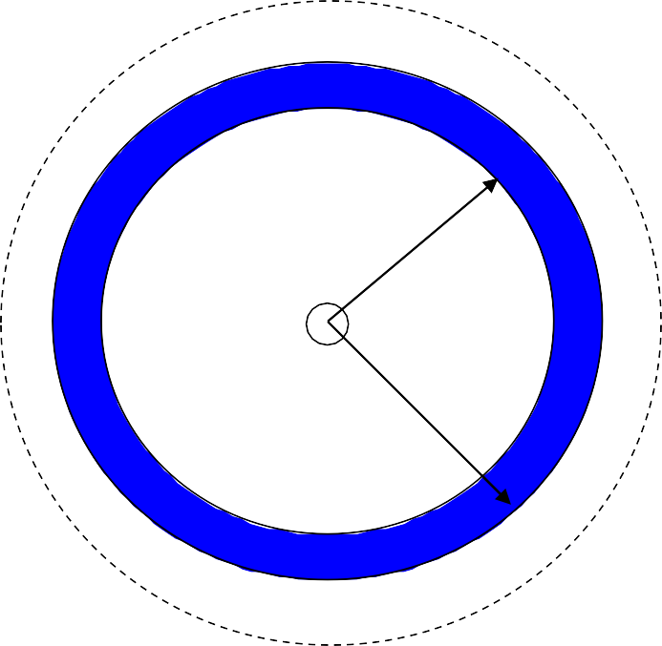

Worked Example 5 cont’d
-Q
Find the field for r > b
From the symmetry of the problem, the field in this
region is radial and everywhere perpendicular to the
a
spherical Gaussian surface. Furthermore, the field has the same value at every point on the Gaussian surface so the solution then proceeds exactly as in Ex. 2, but Q_{in}=2Q-Q.
+2Q
b
r r
_{Ñ∫} E ⋅dA = _{Ñ∫} E dA = E_{Ñ∫} dA = E (4π r² )
Gauss’s law now gives:
E (4π r ² ) = ^{Qin}
₌ 2Q − Q ₌ Q
or E = ^{1 Q} = k ^{Q}
_{r}2
e _{r}2
ε
ε ε
4πε
0
0 0
0

Slide 17



